Slide 1
Attopixel imagers for physics: are these possible and useful?
Erik H.M. Heijne
Inst. of Experimental and Applied Physics
of the Czech Technical University in Prague
CERN EP Department Geneva

Slide 2
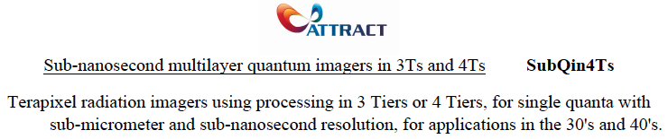
ATTRACT proposal
SubQin4Ts
nm + ps tracking
for colliders 2030 - 2040

Slide 3
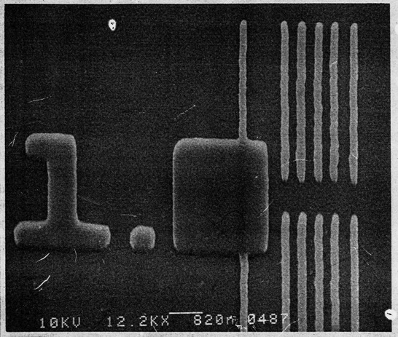
IN ACTION on THE SQUARE MICRON
in 1988 I was surprised
to see how big
can appear
one square micron
Projective ion-Beam etching
pitch lines 150 nm
overall chip was 8mmx8mm
TU Vienna~ 1988

Slide 4

Attopixel
very small pixels could have attofarad capacitance
10pF Si diode detector 1mm thick, 1 cm² area
naïve linear reduction to 1 µm thick, 1µm² area
10⁻¹² F x 10⁺³ x 10⁻⁸ = 10⁻¹⁷ F
then ~ 1 aF for 0.3 x 0.3 µm² area
+1 electron 1.6x 10⁻¹⁹ C ~160mV on 1 aF
also low electronic noise and low power

Slide 5
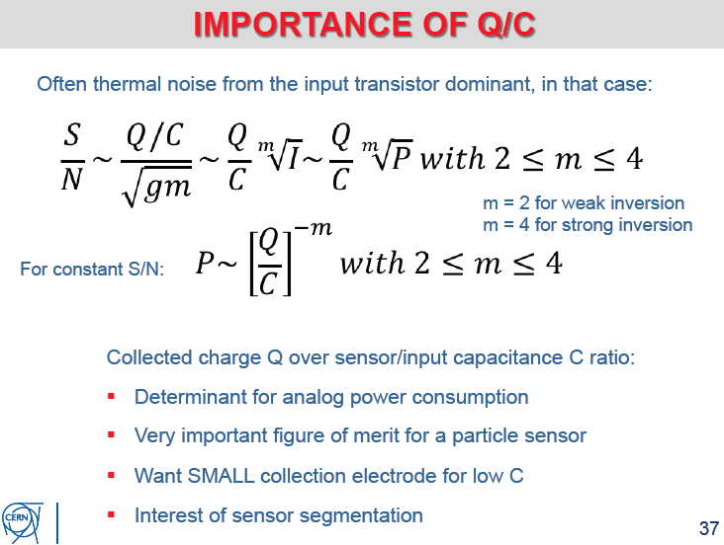
“Conversion Gain”
for mip's
smaller capacitance allows
larger S/N
& lower power
now aim at pixel 3x3x3 µm³
voxel -
not yet attopixel !!
capacitance ~0.3fF
noise few e⁻ rms
mip signal ~140 e⁻
fundamentals from Walter Snoeys
[also better formula for small capacitance]

Slide 6
why small, thin (2-3µm) 3D pixel detectors ?
inherently large signal by ‘conversion gain’ Q/C
saturation for >keV energy deposit ?
low noise <<1 e⁻ rms good S/N even for 40-80 e⁻
10⁴V/cm electrical field at 2-5 V reverse bias
optimum carrier drift velocity
short collection distance little trapping?
fast ~10ps timing
low occupancy, even at >10⁵ tracks/crossing
high cost of R&D + non-recurrent engineering
better to produce these in quantity for large area
what about radhard ? understand technology details

Slide 7
is such a small pixel realistic ? consider progress in Si technology

Slide 8
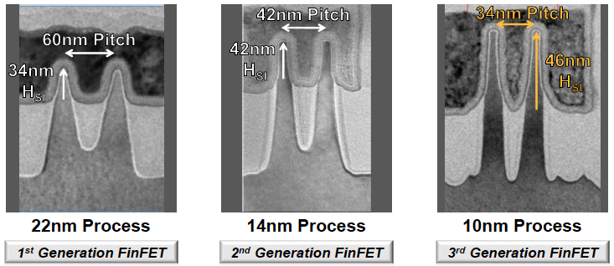
FinFET transistor evolution at Intel
Zheng Guo et al. Intel. ISSCC 2018 paper 11.1

Slide 9
recent Si CMOS imagers 3 examples

Slide 10
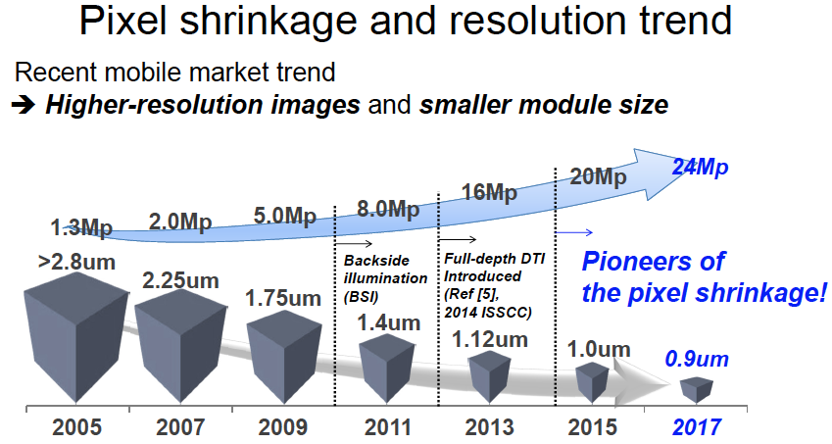
Samsung
Wonchul Choi et al. Samsung; ISSCC 2018 paper 5.3

Slide 11
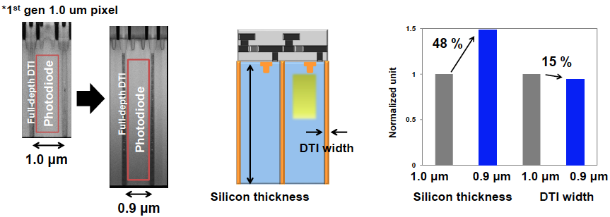
Samsung 0.9 µm imager with deep-etched separation
'thicker' Si : now 4µm instead 2.7µm to improve signal for red
physics does not really need pixel trenches, delta rays cross over

Slide 12
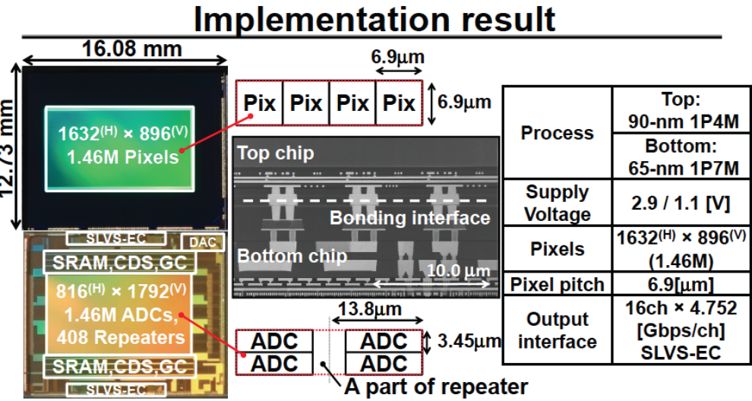
Stacked imager Sony : ADC connected to each pixel
M. Sakakibara et al.Sony; ISSCC 2018 paper 5.1

Slide 13
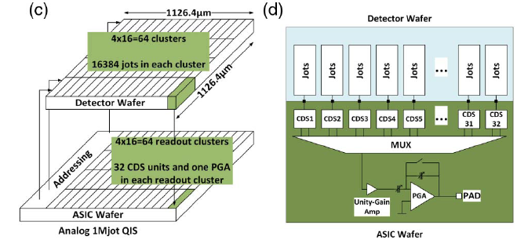
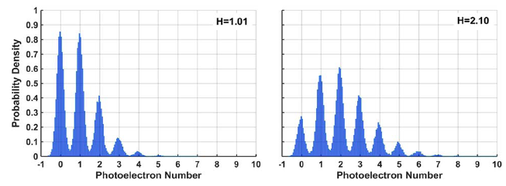
QIS Quanta Image Sensor 1.1µm
J.Ma - team of E. Fossum
Optica 4 (2017) 1474
small pixels = “jot” 1.1x1.1 µm²
sensor wafer
65nm CMOS
readout wafer
“jot cluster”
45nm CMOS
#photons
for one “jot”
two light intensities
20000 reads
each 120 µs
noise 0.17 e-

Slide 14
physics detectors still mostly based on 1970 – 1990 technology
lithography and ion-implantation at ≥µm level
wafer size 100 – 150 mm (readout 200 mm)
signal processing in LHC used 0.25 µm CMOS upgrades now evolve to 90nm or 65nm CMOS
yet: innovative systems, produce good results

Slide 15
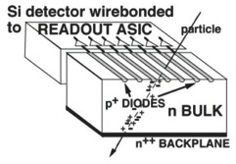
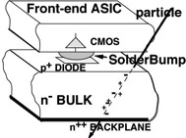
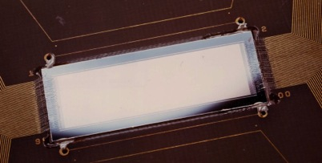
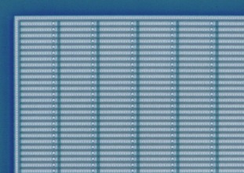
1980 Si sensor “revolutions” 1990
Si Microstrip Detectors
may cover larger area
Si Pixel Detectors
for highest particle densities
1D linear array
diodes50µm x 2-15 cm
depleted bulk ~300µm
2D pixel matrix with bumps
diodes 50µm – 500µm
depleted bulk ~150µm
500µm
30mm
pitch
75µm

Slide 16
Pixel detectors became essential for particle physics at LHC and beyond

Slide 17
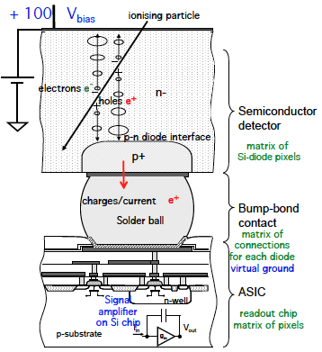
principle of hybrid Si pixel detector/imager/solar cel? energy deposit voltage/current puls
special Si (high-ohmic)
standard Si CMOS chip

Slide 18
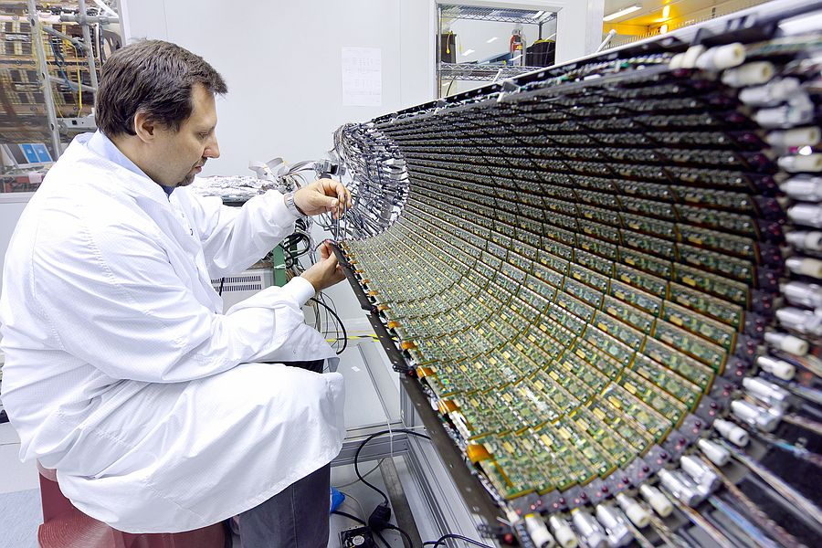
ATLAS inner Si pixel layer
source: CERN- ATLAS

Slide 19
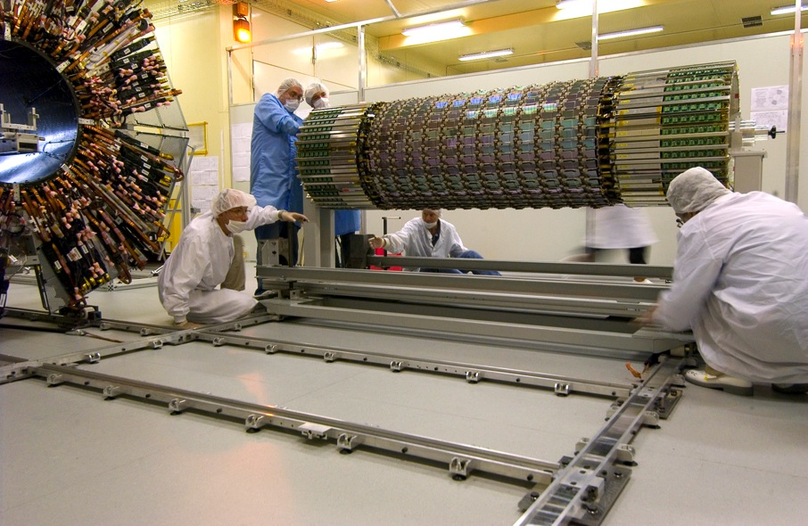
ATLAS Si detectors nearly ready : 2008
source: CERN- ATLAS

Slide 20
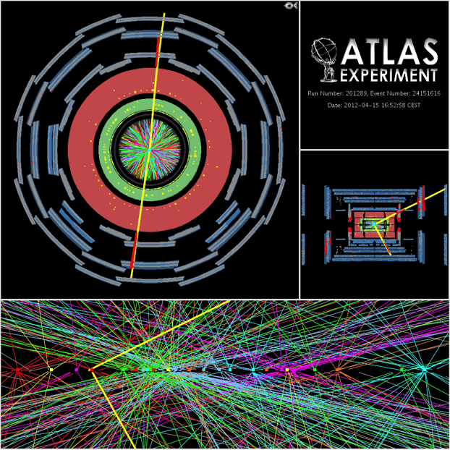
Multiple interactions in each LHC crossing
40 million ‘photos’/s
many more interactions
reconstruction now
possible thanks to
inner Si pixel layers
can we go to
more (even 1000?)
interactions
per crossing?

Slide 21
Pixel detector development after LHC R&D continued in Medipix collaborations 1998 - now aim was to maintain/improve design expertise

Slide 22
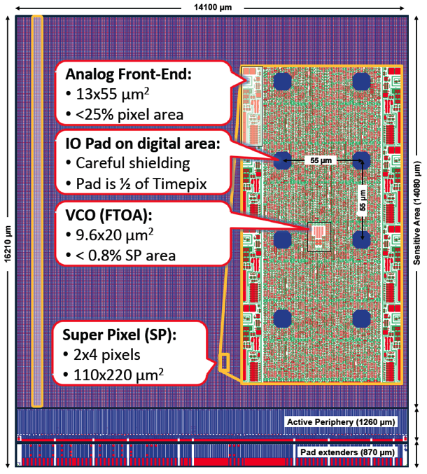
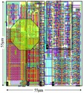
Timepix with brain or usual pixels without
Timepix3 (2013)
Timepix
(2006)

Slide 23
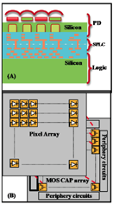
Timepix with brain or usual pixels without
Timepix3 (2013)
V.C. Venezia et al.
IEDM 2018
paper 10.1
4x1.5
6 µm
Timepix
(2006)
same scale
BSI imager
13ke- full well
8Mpixel, dual gain
USA, OmniVision

Slide 24
density in pixel ASICs CERN Medipix team
INTEL 32nm 2007
ClicPix (2013)
ClicPix2(2016)
Medipix4 Timepix4
scale: # transistors per µm²
mm²=10⁶ µm²
Timepix3(2013
VeloPix(2016
Medipix3RX (2011)
Timepix (2006)
Dosepix(2010
Medipix2(2004)
Medipix1 (1998)
slide courtesy Xavi Llopart

Slide 25
hybridization is now ‘hot’ innovation for commercial CMOS imagers amazing: hybrid pixel detectors for physics are becoming disregarded and 1-tier ‘monolithic’ favored we should exploit new industrial capabilities: replace solder bumps by copper connects put more functions in multilayer chips 2-tiers, later on even 3-4 tiers

Slide 26
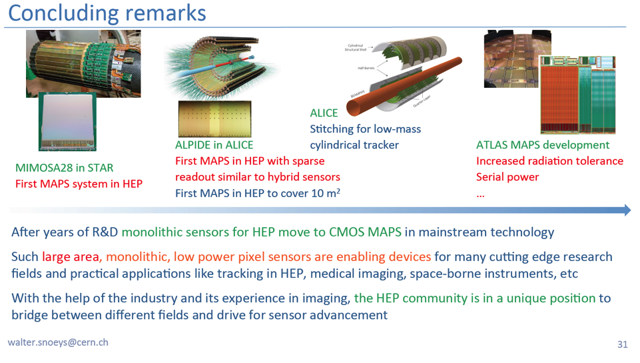
Walter Snoeys on monolthic pixel detectors, March 2019

Slide 27
hybridization is now ‘hot’ innovation for commercial CMOS imagers amazing: hybrid pixel detectors for physics are becoming disregarded and 1-tier ‘monolithic’ favored we should exploit new industrial capabilities: replace solder bumps by copper connects put more functions in multilayer chips 2-tiers, later on even 3-4 tiers

Slide 28
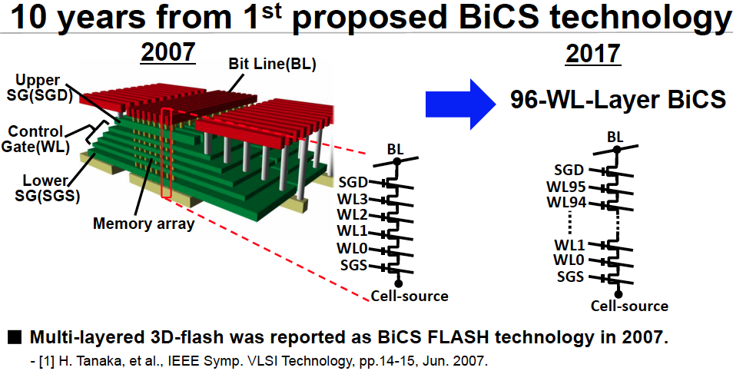
Flash Memory
Hiroshi Maejima et al.Toshiba. ISSCC 2018 paper 20.1 512 Gb 3b/cell

Slide 29
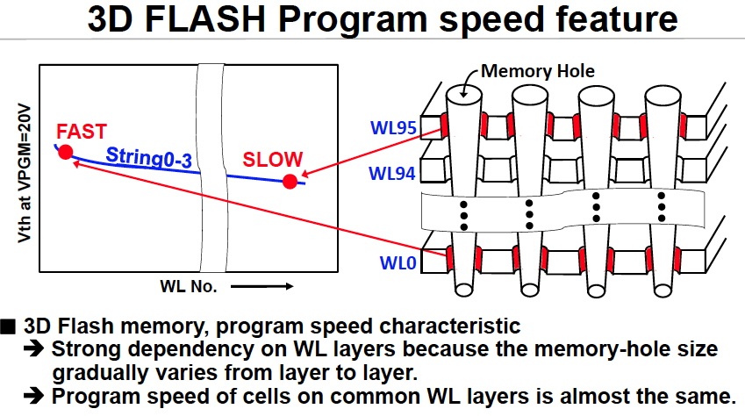
Toshiba holes
Multi-layer USB memory
Hiroshi Maejima et al.Toshiba. ISSCC 2018 paper 20.1

Slide 30
signals of m.i.p. in thin pixel detectors particle energy loss/deposition [a brief overview]

Slide 31
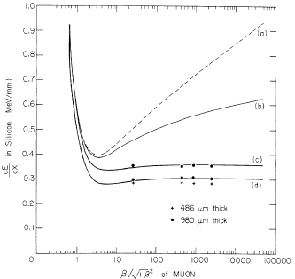
Energy loss muons in silicon
Bethe-Bloch
+ density effect
‘loss’ restricted < 0.5MeV
integrated Landau measured
peak Landau for ~1mm Si
and ~0.5 mm
CERN Yellow Report 83-06

Slide 32
ENERGY LOSS vs ENERGY DEPOSIT
dE/dx CALCULATION SUPPOSES 'INFINITE' ABSORBER
- ALL POSSIBLE TRANSFERS HAVE TO BE REALIZED
- ALL ENERGY LOSS TO BE CONTAINED IN ABSORBER
δ ELECTRON CONTAINED
δ ELECTRON ESCAPES
FOR 'THIN' ABSORBERS CORRECTION NEEDED
resticted energy ‘loss’
introduce limit on energy transfer η

Slide 33
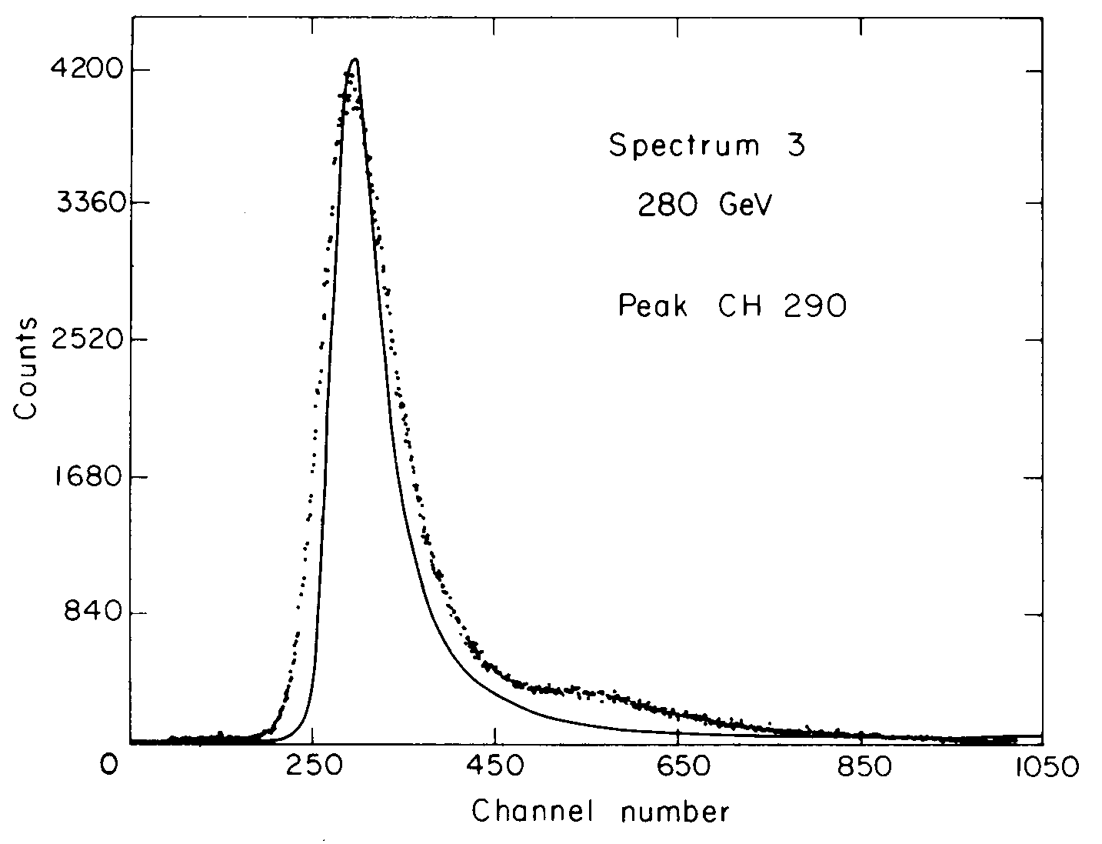
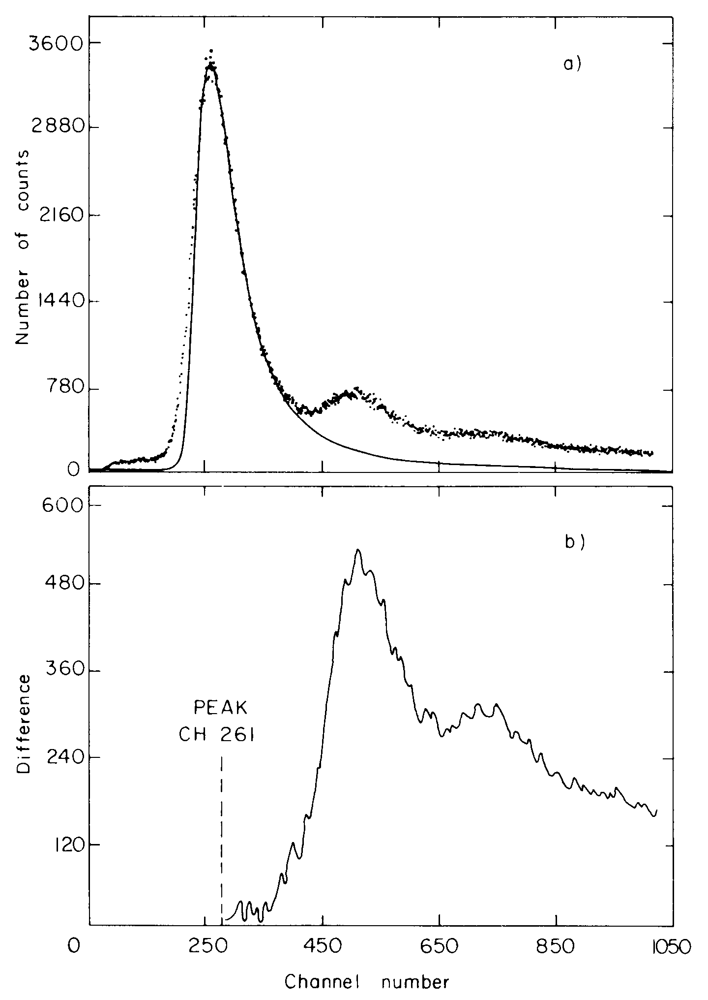
measurements with m.i.p.s in Si (1979)
280 GeV muons
EHN2
PIONS
EHN1 beam H2
OFTEN 2 or 3 PARTICLES
passing through diode !!!
each also follows a Landau distribution
AFTER SUBTRACTION
522
783

Slide 34
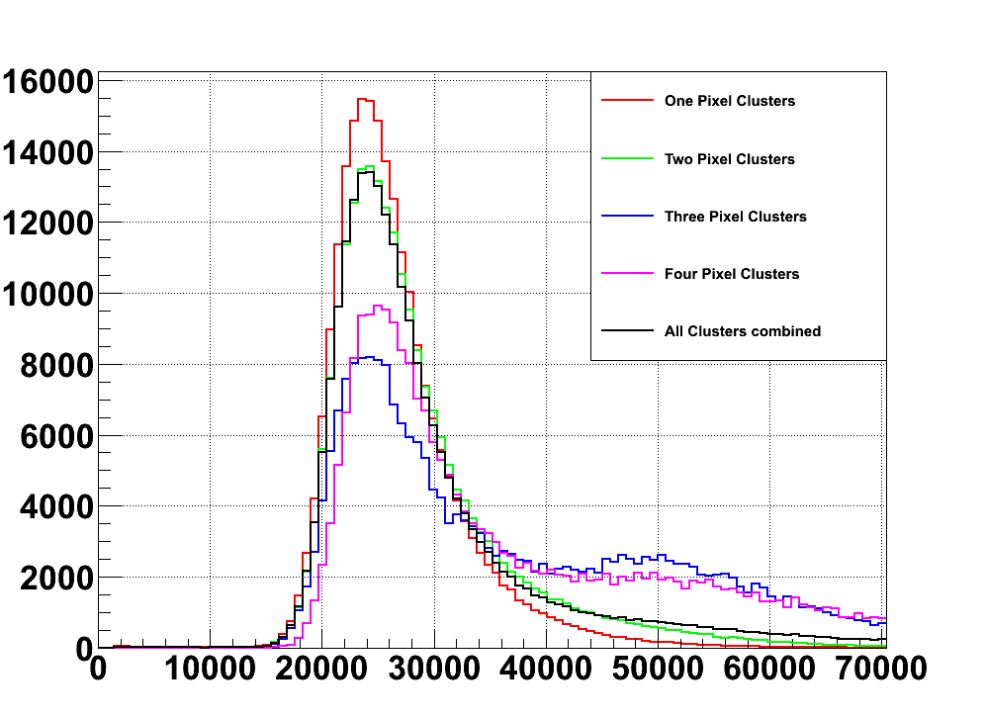
Small pitch pixels: Timepix by LHCb

Slide 35

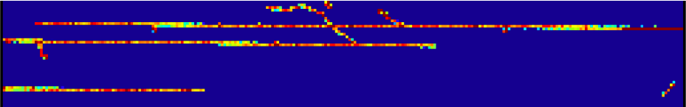
TYPICAL TRAILS ...
T3-1500
T3-1504
T3-1507

Slide 36
now look at real thin pixel detectors simulations 1 - 3 - 5.6 µm measurements 5.6 – 120 µm using 12 GeV protons at grazing angle Perugia team (Passeri, Meroli, Servoli,..)

Slide 37
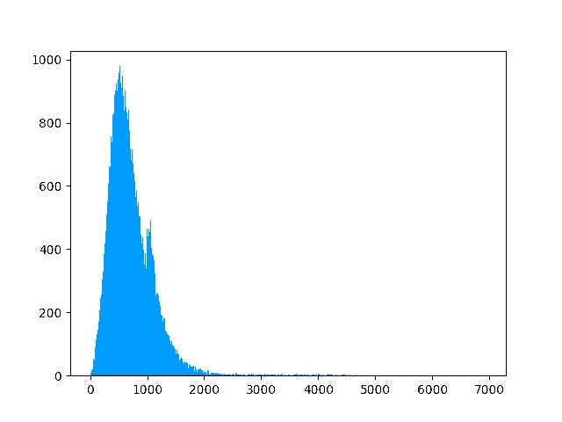


Landau distribution 3 µm Si Geant4
quick simulation Lukas Tlustos
eV
e-h pairs
eV
e-h pairs
0
500
1000
no visible change
with readout chip
behind the thin sensor
most probable value 130 e⁻
width FWHM 180 e⁻

Slide 38
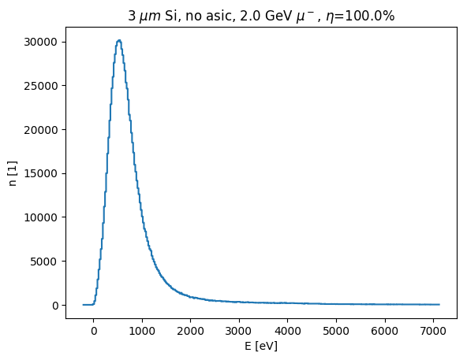
Landau distribution 3 µm Si Geant4
+ newer simulation Lukas Tlustos
eV
e-h pairs
eV
e-h pairs
0
500
1000
no visible change
with readout chip
behind the thin sensor
most probable value 130 e⁻
width FWHM 180 e⁻
2nd peak is artefact

Slide 39
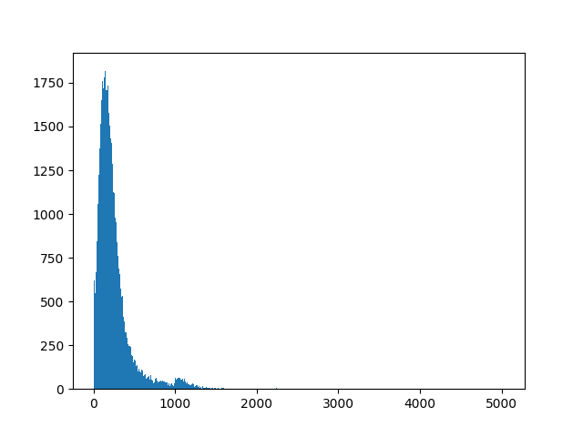
Landau 3 and 1 µm Si Geant4
quick simulation
eV
e-h pairs
eV
e-h pairs
0
500
1000
1 µm layer appears to record
some events with zero loss
really correct???
2.2% mentioned by Wang et al.
NIM A899(2018) 1-5 (ATLAS/LBL)
most probable value 130 e⁻
width FWHM 180 e⁻

Slide 40
Landau 3 and 1 µm Si Geant3
simulation Lukas Tlustos
eV
e-h pairs
eV
e-h pairs
0
500
1000
0
500
1000
1 µm sensor
most probable value <40 e⁻
width FWHM 50 e⁻
most probable value 130 e⁻
width FWHM 180 e⁻

Slide 41
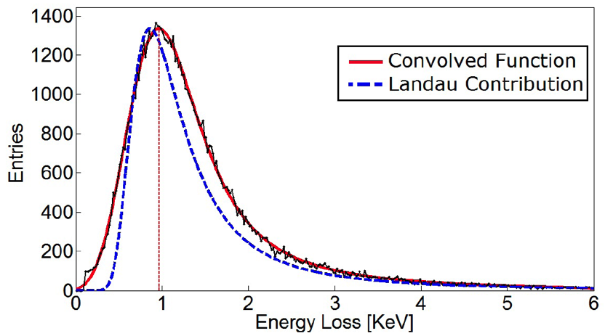
12 GeV protons in 5.6µm Si imager
black points/curve measured
well represented after convolution
Perugia group (– CMS)
Meroli et al. JINST 6 (2011) P06013
this team is also collaborating in ATTRACT proposal SubQin4Ts

Slide 42

Landau 5.6, 3 and 1 µm Si + experiment
data 12 GeV protons
Landau curves simulated
Perugia team
eV
e-h pairs
eV
e-h pairs
0
500
1000
0
500
1000
5.6 µm sensor
most probable value 270±10 e⁻
width FWHM 285±3 e⁻
Meroli et al. JINST 6 (2011) P06013
most probable value 130 e⁻
width FWHM 180 e⁻

Slide 43
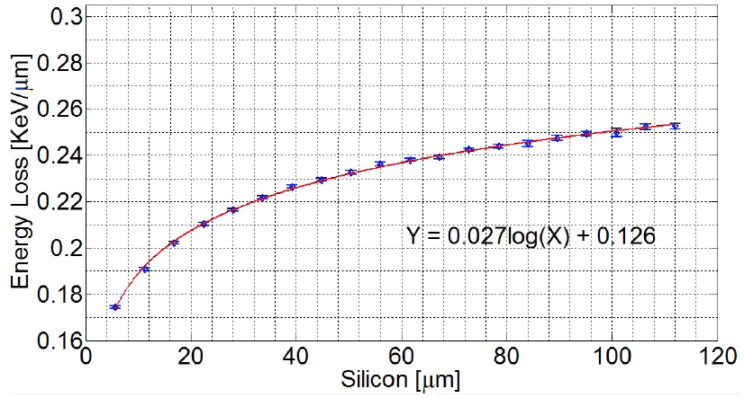
12 GeV protons in 5.6 – 120 µm Si
measured using grazing incidence along pixels
80
70
e-h pairs per µm
60
50
40
Perugia group
Meroli et al. JINST 6 (2011) P06013

Slide 44
12 GeV protons in 5.6 – 120 µm Si
using grazing incidence along pixels
80
70
e-h pairs per µm
60
50
1 µm sim
40
Perugia group
Meroli et al. JINST 6 (2011) P06013
simulations 1 – 3 µm added

Slide 45
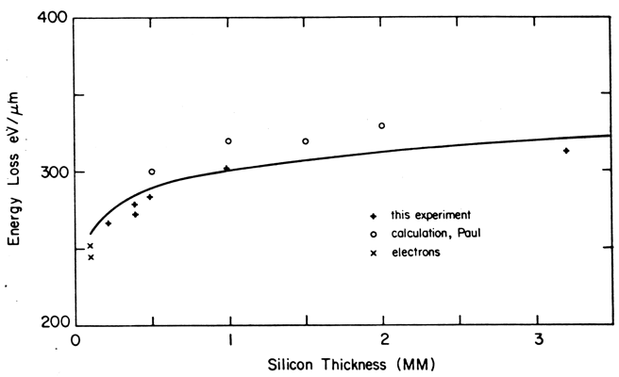
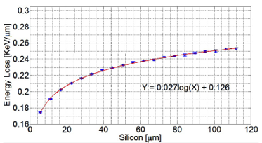
comparison with earlier data
deposit / µm is decreasing tracking mip is ONLY aim
old work:
Heijne CERN 83-06 (1983) 30
+refs in there
Bak et al.
Nucl. Phys. B288 (1987) 681
more recent:
Meroli et al.
J. Instr 6 (2011) P06013
is there probability for
ZERO signal ??
eV/µm
e-h PAIRS PER µm
Heijne CERN 83-06 (1983) 30
¹⁰⁰ --
--- LIMIT:mean value in thick Si 360 eV/µm ------
⁹⁰ --
⁸⁰ --
HEIJNE
⁷⁰ --
CALC
GRUHN e
⁶⁰ --
+ 220 eV 25µm
Meroli et al.
J. Instr 6 (2011) P06013
< 1mm BINDING of ELECTRONS causes
deviation from Landau distribution: shift+widening
values for VERY thin devices: <55 e-h pairs/µm
transfers via plasmons of 20eV
bandgap 1.12eV -→ 3.64eV/pair
+ 220 eV 25µm

Slide 46
can mip’s give zero signal in 1 µm Si layer ? as simulated by Geant4 & Allpix these use ‘Bichsel’model with ‘large’ transfers however, look at EELS results we may have to update Allpix task for SubQin4Ts

Slide 47
The basic, small energy transfers - plasmons
Measurements of probability of only single transfer in thin Si layer
EELS Electron Energy Loss Spectroscopy
100 nm Si sheet Stiebling & Raether, Phys Rev Lett 40 (1978) 1293
25 & 480 nm Si sheets Egerton, Rep Prog Phys 72 (2009) 016502 (next slide)
multiples of 16.7 eV plasmon energy
mean-free-path between events 115nm
no deposit in 1µm Si seems unlikely ??
E
ε
ο
E - ε
MAGNETIC SPECTROMETER
TYPICAL TRANSFER is PLASMON with 16.7 eV
COLLECTIVE ELECTRON OSCILLATION
energy needed for bandgap ionization >1.12 eV mean e-h PAIR 3.64 eV
smaller transfers <1.12 eV can only give ’heat'
17.4 eV plasmons result inionizations + heat

Slide 48
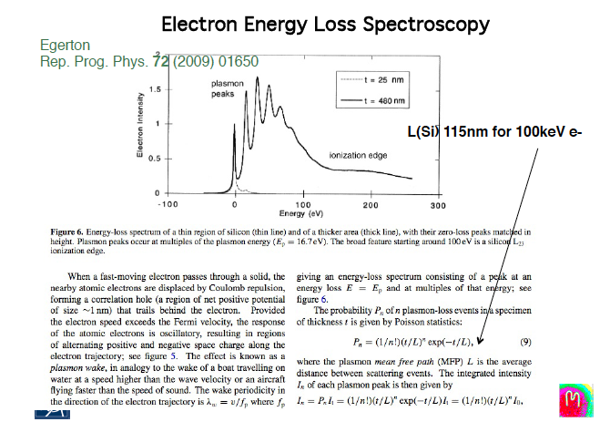
mean scattering length
25 nm thin Si
480 nm thin Si
first peak 16.7 eV; zero peak much reduced

Slide 49
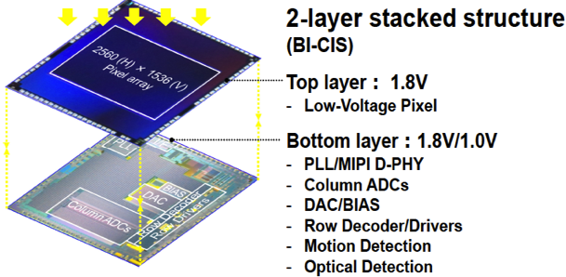
ATTRACT proposal
aims: checking signal generation in 1-6 µm thin Si pixels
review existing or upcoming technologies for 2(-3-4) layer stacking
find possibilities for access to such technologies
1.5 µm pixels
event driven
10b ADC
Oichi Kumagai et al., Sony
ISSCC 2018 paper 5.4

Slide 50
Future particle imagers at colliders
advantages for 3µm pixels, also in multiple layers
<< ns signal collection improves timing precision
short signal path improves radiation hardness
reduced carrier trapping probability
high field possible even at 1-5 volts
reduction of coordinate corruptions by delta electrons
track vector parameters locally available
possibility to determine primary vertex at 1st level
....

Slide 51
Some Conclusions
Technical innovation essential for physics progress
silicon still offers possibilities for new approaches
Electronics determines sensors and systems
'ultra'pixels implemented in advanced nanotechnologies?
Low noise achieved by sensor segmentation
segmentation is also solution for dark current, even mA
pixel detectors for high multiplicity and nm positions
Timing at ps precision is next frontier
avalanche layer or attopixels ? light is faster than electrons
Other technologies?
stacking of active layers integrated cooling
more points for more realistic imaging

Slide 52
Future experiments will rely on newest electronics need timely R&D efforts, expertise and resources worldwide collaboration & tens of millions to do it right Thank You

Slide 53
There's plenty of room at the bottom Richard P. Feynman 1959, APS at Caltech

Slide 54
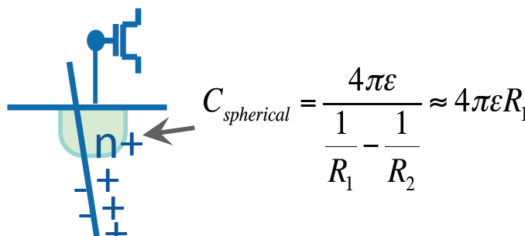
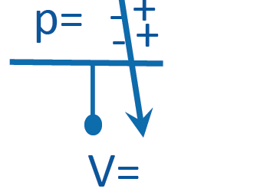
capacitance determination nm dimensions
R₂ distance to rear contact
large compared to thickness R₁
Walter Snoeys

Slide 55
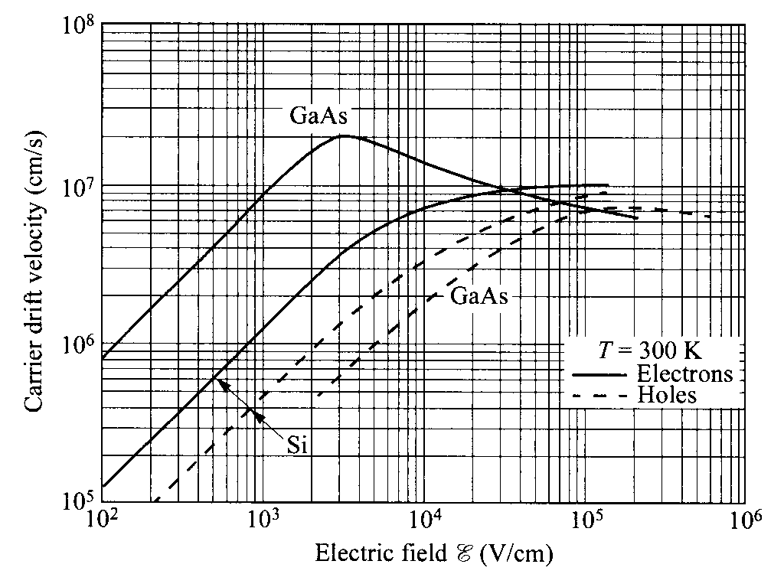
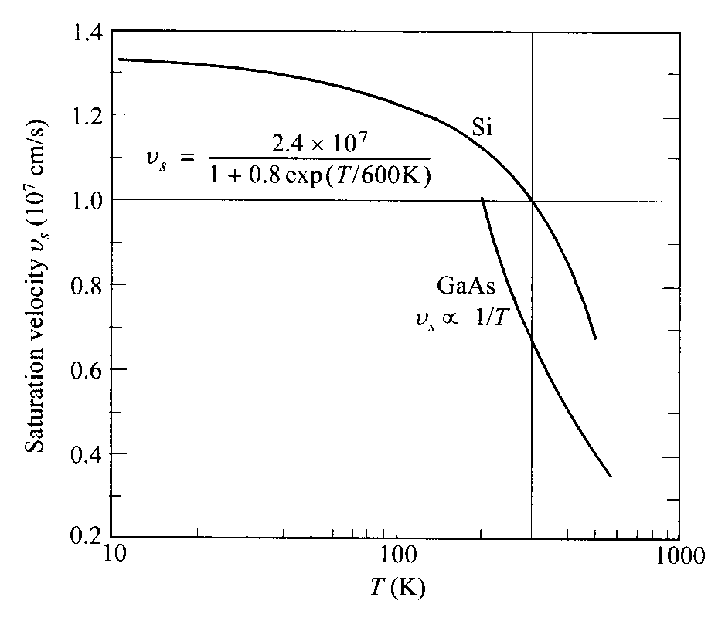
CARRIER TRANSPORT in Si and GaAs
Carrier drift velocity vs field
Saturation vs temp
100km/s
RT
<--- lower temp
carrier mobility is a function of doping, temp, field..
semiconductor detectors are INHERENTLY fast : 5 - 20 ns
speed of light still much higher 3x10⁵ km/s 360 000 km/h

Slide 56
End

